Slide 1

Revature: Project 2 Presentation
Presented By: Brandon Hanzlick, Jessica Hori, Jason McClintock, Melissa Auclaire and Shawn Sampson
Class ID: 220314-UTA-SH-Scala-Big Data
GitHub: https://github.com/sampss/RevProject_2
Notes:
Jessica

Slide 2









Notes:
Jessica

Slide 3


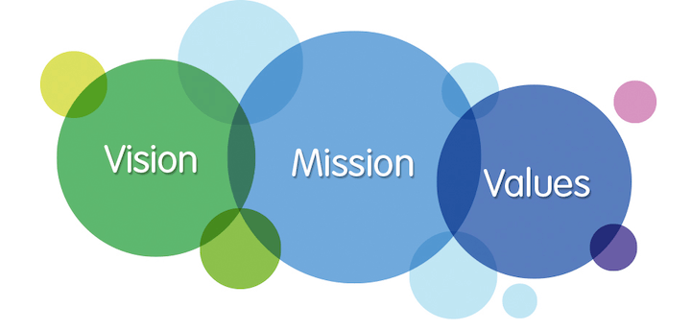



Agenda
Project Background
Mission Statement
Dataset
Queries/Analysis
Enhancements
Conclusion
Notes:
Jason

Slide 4
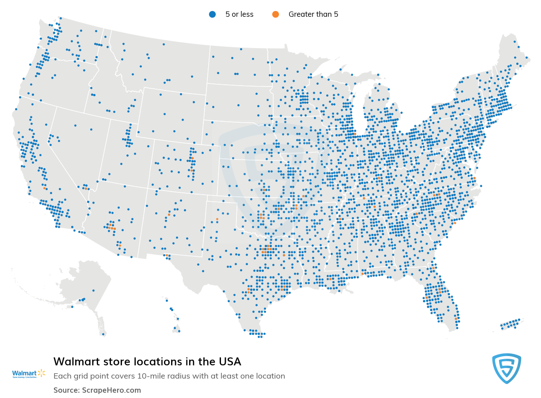

Project Background
Historical sales data for 45 Walmart stores located in different regions
The objective is to determine the factors affecting sales and to analyze the impact of markdowns around holidays on the sales, while also evaluating retail store off-season performance.
Notes:
Jason

Slide 5
Mission Statement
Vision: “Be the destination for customers to save money, no matter how they want to shop.”
Core Values: “customer first, frontline focused, innovative & agile, listen, inclusive, high performance, accountable, honesty, and fairness”
Source: https://mission-statement.com/walmart/#:~:text=Walmart's%20mission%20statement%20is%20%E2%80%9Cto,difference%20in%20anything%20it%20touches.
Notes:
Brandon

Slide 6
Walmart’s yearly revenue:
On the rise since the very start: Walmart’s annual revenue has witnessed significant growth since 2012.
In 2020, annual Walmart’s revenue had an increase of 1.86% compared to 2019 (Source: Statista, Macrotrends).
This data will allow us to understand how we can continue that trend of growth in future projections and financial quarters.
Question: How many customers visit Walmart daily?
According to Statista’s visitor statistics regarding Walmart and it’s daily foot traffic, in 2020, an estimated average of 37 million people used these stores across the planet (Source: Statista).
Our data specifically works with Retail Data - so the data we are using here is relevant to the 37 million customers visiting the physical location of the store in person, every single day.
Notes:
Brandon

Slide 7
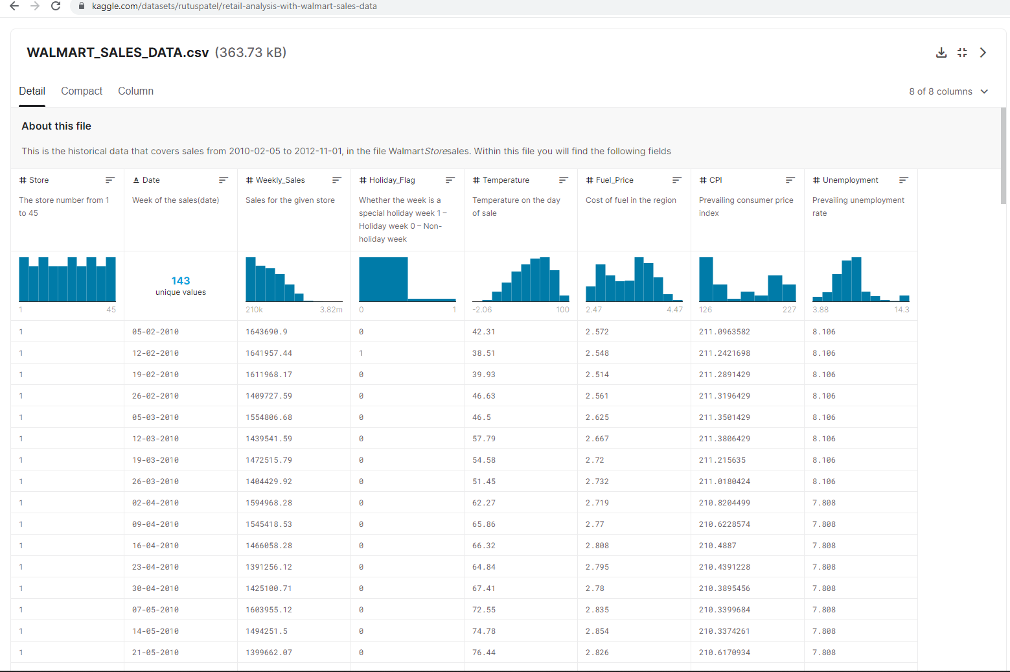
Dataset - Retail Analysis With: Walmart Sales Data
The business is facing a challenge due to unforeseen demands and runs out of stock some times.
Walmart would like to predict the sales and demand accurately.
The goal is to predict demand accurately, and with respect to factors like economic conditions which includes, but is not limited to: Fuel Price, CPI (Prevailing Consumer Price Index), and UI (Unemployment Index).
Dataset comes from: https://www.kaggle.com/datasets/rutuspatel/retail-analysis-with-walmart-sales-data
Source: https://www.kaggle.com/datasets/rutuspatel/retail-analysis-with-walmart-sales-data
Notes:
Shawn
For the first insight we have to ask the question…
Move to slide 8

Slide 8
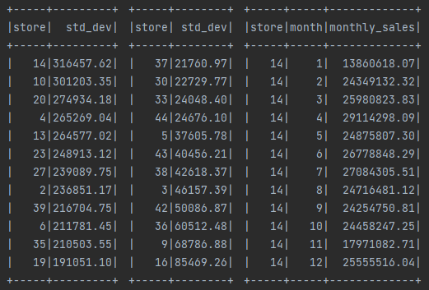
Which store has the maximum standard deviation? What does the deviation tell us and what insights can we gain?
spark.sql("use wmdata")
val df = spark.sql("select * from sales")
val df1 = df.groupBy("store").agg( stddev_pop("weekly_sales").cast("decimal(38,2)").as("std_dev"))
df1.orderBy(desc("std_dev")).limit(10).show
Between the months of April until July there are three major fluctuations from a 15% drop to a 8% increase and back down another 9%.
Store 37 which performs pretty consistently regardless of holidays or if it is off season.
Data is invaluable in assessing specific performance needs
Notes:
Shawn
My associate Jessica will be presenting our next insight regarding the store with the maximum number of sales over our dataset. Move to slide 9 Why would a store have inconsistent sales numbers?
How can we improve consistency?
The other stores that consistently do well, what are the factors most relevant?
What does the average store do well? Why is the average score such an important numerical figure to know?

Slide 9
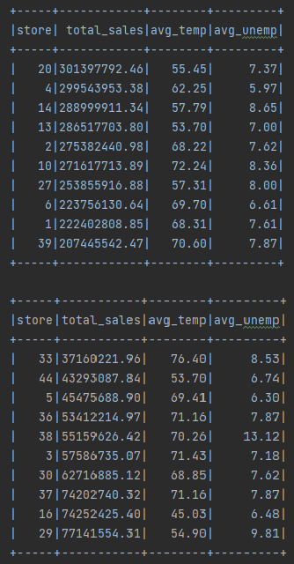
Which store had the maximum number of sales?
spark.sql("use wmdata")
val df = spark.sql("select * from sales")
val dfq1 = df.groupBy("store")
.agg(
sum("weekly_sales").cast("decimal(32,2)").as("total_sales"),
avg("temperature").cast("decimal(32,2)").as("avg_temp"),
avg("fuel_price").cast("decimal(32,2)").as("avg_fuel_price"),
avg("unemployment").cast("decimal(32,2)").as("avg_unemployment")
val dfq1a = dfq1.orderBy(desc("total_sales")).limit(10)
val dfq1b = dfq1.orderBy(asc("total_sales")).limit(10)
Store 20 had the largest sales.
In 2012 Hialeah Gardens supercenter was the top-producing Walmart.
The Doral Walmart had highest sales of any store during 2014.
These 2 stores are consistently within the top 3 stores in the country (and possibly the world) for sales.
Notes:
Jessica
What makes a single store perform better than the others?
List some contributing factors.
Relate it back to the original question: How do the holidays impact this store?
Why does this store benefit from the holidays?
There are certain events and holidays which impact sales on each day:
Super Bowl
Labour Day
Thanksgiving
Christmas

Slide 10
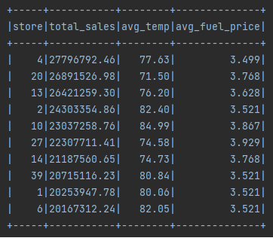
Which store(s) had a good Quarterly Growth in Q3, 2012?
spark.sql("use wmdata")
val df = spark.sql("select * from sales")
df1 = df.filter(year(col("date")) === 2012 and quarter(col("date")) === 3 )
val df2 = df1.groupBy("store")
.agg(
sum("weekly_sales").cast("decimal(38,2)").as("total_sales"),
avg("temperature").cast("decimal(4,2)").as("avg_temp"),
avg("fuel_price").cast("decimal(38,3)").as("avg_fuel_price") )
df2.orderBy(desc("total_sales")).limit(10).show
Growth can indicate a turn-around in terms of a specific business timeframe as it is relevant to a store’s performance .
Summer is starting time for a barbecue
Time to go camping
Back to school and time to start college
Notes:
Jason
Understanding what went well in one quarter can help us understand how these stores can continue to do well.
And the other stores that have not done well? Perhaps there is information here which other stores are able to implement in order to improve sales
We can definitively find out which stores are performing and which are not

Slide 11
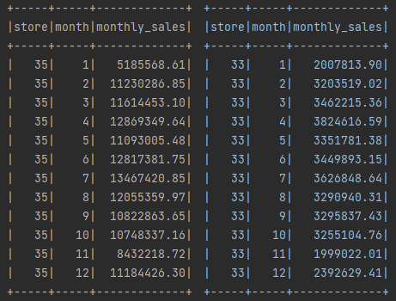
Holidays which have higher sales than the mean sales in non-holiday season for all stores together
val df2 = df.withColumn("month", month(col("date")))
val df3 = df2.groupBy("store", "month").agg( sum("weekly_sales").cast("decimal(38,2)").as("monthly_sales"))
val df4 = df3.select( "store", "month", "monthly_sales" )
val df5 = df4.filter(df4("month") === "2" || df4("month") === "9" || df4("month") === "11" || df4("month") === "12")
val df5a = df4.filter(df4("month") =!= "2" && df4("month") =!= "9" && df4("month") =!= "11" && df4("month") =!= "12")
val df6 = df5.groupBy("store").agg(
mean("monthly_sales").cast("decimal(38,2)").as("holiday_avg_mo_sales"))
val df7 = df5a.groupBy("store").agg(
mean("monthly_sales").cast("decimal(38,2)").as("offseason_avg_mo_sales"))
val df8 = df6.join(df7,df6("store") === df7("store"),"inner" )
df8.orderBy(asc("holiday_avg_mo_sales"),desc("offseason_avg_mo_sales")).limit(10).show()
df8.orderBy(desc("holiday_avg_mo_sales"),asc("offseason_avg_mo_sales")).limit(10).show()
Major holidays and events can have a significant impact on the total sales performance of any given store.
Some stores perform better during the off-season.
Notes:
Melissa

Slide 12
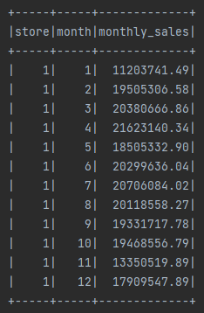
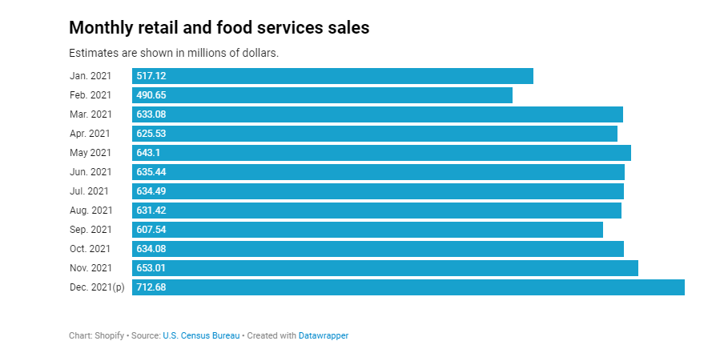
Provide a monthly view of sales for any chosen particular store in any given year
spark.sql("use wmdata")
val df = spark.sql("select * from sales")
val df1 = df.withColumn("month", month(col("date")))
val df2 = df1.groupBy("store", "month").agg( sum("weekly_sales").cast("decimal(38,2)").as("monthly_sales"))
df3.orderBy("store", "month").limit(10).show
Store one’s performance drops off significantly in January, after Christmas 3 years in a row.
Having this data is invaluable in terms of being able to understand our customers, and identify what we can do for them.
What can we do when business is slow?
To note: On average, 65% of a brand’s total revenue comes from returning customers.
Notes:
Brandon
What units sell better during the holidays? Which sell worse?
How can we prepare for the holidays using this data?
Looking long term: Semester sales. What do they mean? Do some products continue to sell after the holidays?
For example, Christmas products after Christmas Day?

Slide 13
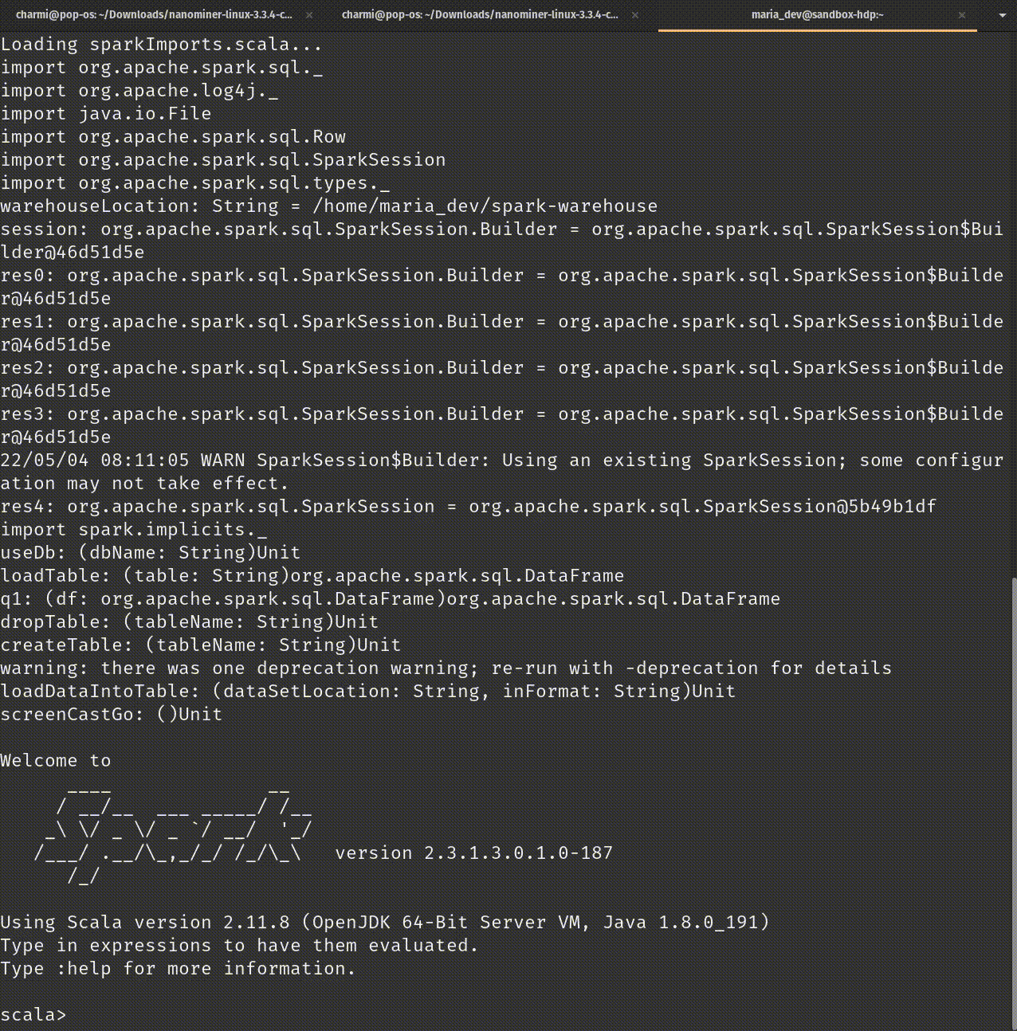
DEMO: Highest Sales &
Lowest Sales
Notes:
Brandon

Slide 14

Enhancements to Project 2
Using recent data for better sales analysis.
Using a larger data set.
Proximity of competitors and difference in sales numbers.
Does Walmart price matching aid in growth?
Notes:
Jason Include what we would have like to have done
What obstacles we encountered
Anything else to mention?

Slide 15
Conclusion
Data can give us an in depth analysis of every product in every store
With over 10,000 stores worldwide, we need this data so that we can understand how every store functions (Source: Statista). We can see what works, and apply it. We can see what doesn’t work, and improve it.
When it comes to the retail sales shares, 9.5% was the Walmart market share in 2020, compared to Amazon’s 9.2% (Source: Pymnts). Walmart is still the most prominent retail store worldwide.
Thus, retail store performance is still just as relevant as online sales.
The store has been the forefront of Walmart for decades, and it will continue to be for decades more to come!
Notes:
Melissa

Slide 16
Citations (Works Cited, By Order of Appearance)
Image 1, Revature Logo from: revature.com Technology Talent Development | Technology Solutions | Revature
Image 2, https://asana.com/resources/project-brief
Image 3, https://www.wordstream.com/blog/ws/2021/07/02/how-to-write-a-business-mission-statement
Image 4, https://dataschools.education/resource/useful-datasets-for-data-education-in-schools/
Image 5, https://www.ubalt.edu/merrick/graduate-programs/mba/mba-program-requirements/dataanalytics.cfm
Image 6, https://www.indraconsulting.com/performance-focused-organisations/process-size/
Image 7, https://www.vecteezy.com/vector-art/2423035-business-idea-concept-illustration-great-for-web-design-landing-page-and-banner-vector-flat-design
Image 8, https://adage.com/section/Super-Bowl-Commercial-Updates/792
Image 9, https://nationaltoday.com/labor-day/
Image 10, https://www.fayobserver.com/story/lifestyle/2021/11/18/fayetteville-nc-where-get-thanksgiving-dinner-2021/8648861002/
Image 11, https://disneyworld.disney.go.com/events-tours/holidays/
Image 12, https://www.walmart.com/cp/walmart-pay/3205993
Image 13, https://mission-statement.com/walmart/#:~:text=Walmart's%20mission%20statement%20is%20%E2%80%9Cto,difference%20in%20anything%20it%20touches.
Dataset, Dataset Information: https://www.kaggle.com/datasets/rutuspatel/retail-analysis-with-walmart-sales-data?resource=download
https://www.kaggle.com/datasets/rutuspatel/retail-analysis-with-walmart-sales-data
Wal-Mart Data Facts: https://capitalcounselor.com/walmart-statistics/
Statista,
Macrotrends,
Walmart Revenues, Profits,
Pymnts
https://capitalcounselor.com/walmart-statistics/
Notes:
Questions

